Slide 1
JENKINS

Slide 2
Advanced Syntax for Pipeline
String interpolation:
Jenkins Pipeline uses rules identical to Groovy for string interpolation. Groovy’s String interpolation support can be confusing to many newcomers to the language. While Groovy supports declaring a string with either single quotes, or double quotes, for example:
def singlyQuoted = 'Hello’
def doublyQuoted = "World“
Only the latter string will support the dollar-sign ($) based string interpolation, for example:
def username = 'Jenkins’
echo 'Hello Mr. ${username}’
echo "I said, Hello Mr. ${username}“
Would result in:
Hello Mr. ${username}
I said, Hello Mr. Jenkins
Working with the Environment:
Jenkins Pipeline exposes environment variables via the global variable env, which is available from anywhere within a Jenkinsfile.
BUILD_ID
The current build ID, identical to BUILD_NUMBER for builds created in Jenkins versions 1.597+

Slide 3
BUILD_NUMBER
The current build number, such as "153"
BUILD_TAG
String of jenkins-${JOB_NAME}-${BUILD_NUMBER}. Convenient to put into a resource file, a jar file, etc for easier identification
BUILD_URL
The URL where the results of this build can be found (for example http://buildserver/jenkins/job/MyJobName/17/ )
EXECUTOR_NUMBER
The unique number that identifies the current executor (among executors of the same machine) performing this build. This is the number you see in the "build executor status", except that the number starts from 0, not 1
JAVA_HOME
If your job is configured to use a specific JDK, this variable is set to the JAVA_HOME of the specified JDK. When this variable is set, PATH is also updated to include the bin subdirectory of JAVA_HOME
JENKINS_URL
Full URL of Jenkins, such as https://example.com:port/jenkins/ (NOTE: only available if Jenkins URL set in "System Configuration")
JOB_NAME
Name of the project of this build, such as "foo" or "foo/bar".
NODE_NAME
The name of the node the current build is running on. Set to 'master' for the Jenkins controller.
WORKSPACE
The absolute path of the workspace

Slide 4
Referencing or using these environment variables can be accomplished like accessing any key in a Groovy Map.
for example:
// Declarative //
pipeline {
agent any
stages {
stage('Example') {
steps {
echo "Running ${env.BUILD_ID} on ${env.JENKINS_URL}"
}
}
}
}
// Script //
node {
echo "Running ${env.BUILD_ID} on ${env.JENKINS_URL}“
}
Setting environment variables:
Setting an environment variable within a Jenkins Pipeline is accomplished differently depending on whether Declarative or Scripted Pipeline is used.
Declarative Pipeline supports an environment directive, whereas users of Scripted Pipeline must use the withEnv step.

Slide 5
// Declarative //
pipeline {
agent any
environment { ①
CC = 'clang'
}
stages {
stage('Example') {
environment { ②
DEBUG_FLAGS = '-g'
}
steps {
sh 'printenv'
}
}
}
// Script //
node {
/* .. snip .. */
withEnv(["PATH+MAVEN=${tool 'M3'}/bin"]) {
sh 'mvn -B verify'
}
}

Slide 6
① An environment directive used in the top-level pipeline block will apply to all steps within the Pipeline.
② An environment directive defined within a stage will only apply the given environment variables to steps within the stage.
Parameters:
Declarative Pipeline supports parameters out-of-the-box, allowing the Pipeline to accept userspecified parameters at runtime via the parameters directive.
Configuring parameters with Scripted Pipeline is done with the properties step.
If you configured your pipeline to accept parameters using the Build with Parameters option, those parameters are accessible as members of the params variable.
Assuming that a String parameter named "Greeting" has been configuring in the Jenkinsfile, it can access that parameter via ${params.Greeting}:
// Declarative //
pipeline {
agent any
parameters {
string(name: 'Greeting', defaultValue: 'Hello', description: 'How should I
greet the world?')
}
stages {
stage('Example') {
steps {
echo "${params.Greeting} World!"
}
}
}
}
// Script //
properties([parameters([string(defaultValue: 'Hello', description: 'How should I greet
the world?', name: 'Greeting')])])
node {
echo "${params.Greeting} World!"
}

Slide 7
Handling Failures:
Declarative Pipeline supports robust failure handling by default via its post section which allows declaring a number of different "post conditions" such as: always, unstable, success, failure, and changed.
The Pipeline Syntax section provides more detail on how to use the various post conditions.
// Script //
node {
/* .. snip .. */
stage('Test') {
try {
sh 'make check'
}
finally {
junit '**/target/*.xml'
}
}
/* .. snip .. */
}
// Declarative //
pipeline {
agent any
stages {
stage('Test') {
steps {

Slide 8
sh 'make check'
}
}
}
post {
always {
junit '**/target/*.xml'
}
failure {
mail to: team@example.com, subject: 'The Pipeline failed :('
}
}
}
Using multiple agents:
In all the previous examples, only a single agent has been used. This means Jenkins will allocate an executor wherever one is available, regardless of how it is labeled or configured.
Not only can this behavior be overridden, but Pipeline allows utilizing multiple agents in the Jenkins environment from within the same Jenkinsfile, which can helpful for more advanced use-cases such as executing builds/tests across multiple platforms.
In the example below, the "Build" stage will be performed on one agent and the built results will be reused on two subsequent agents, labelled "linux" and "windows" respectively, during the "Test" stage.
// Script //
stage('Build') {
node {
checkout scm
sh 'make'

Slide 9
stash includes: '**/target/*.jar', name: 'app' ①
}
}
stage('Test') {
node('linux') { ②
checkout scm
try {
unstash 'app' ③
sh 'make check'
}
finally {
junit '**/target/*.xml'
}
}
node('windows') {
checkout scm
try {
unstash 'app'
bat 'make check' ④
}
finally {
junit '**/target/*.xml'
}
}
}

Slide 10

// Declarative //
pipeline {
agent none
stages {
stage('Build') {
agent any
steps {
checkout scm
sh 'make'
stash includes: '**/target/*.jar', name: 'app' ①
}
}
stage('Test on Linux') {
agent { ②
label 'linux'
}
steps {
unstash 'app' ③
sh 'make check'
}
post {
always {
junit '**/target/*.xml'
}
}
}

Slide 11
stage('Test on Windows') {
agent {
label 'windows'
}
steps {
unstash 'app'
bat 'make check' ④
}
post {
always {
junit '**/target/*.xml'
}
}
}
}
Pipeline follows the Groovy language convention of allowing parentheses to be omitted around
method arguments.
Many Pipeline steps also use the named-parameter syntax as a shorthand for creating a Map in
Groovy, which uses the syntax [key1: value1, key2: value2]. Making statements like the following
functionally equivalent:
git url: 'git://example.com/amazing-project.git', branch: 'master'
git([url: 'git://example.com/amazing-project.git', branch: 'master'])

Slide 12
For convenience, when calling steps taking only one parameter (or only one mandatory parameter), the parameter name may be omitted, for example:
sh 'echo hello' /* short form */
sh([script: 'echo hello']) /* long form */
Advanced Scripted Pipeline:
Scripted Pipeline is a domain-specific language based on Groovy, most Groovy syntax can be used in Scripted Pipeline without modification.
Parallel execution:
The example in the section above runs tests across two different platforms in a linear series. In practice, if the make check execution takes 30 minutes to complete, the "Test" stage would now take 60 minutes to complete!
Fortunately, Pipeline has built-in functionality for executing portions of Scripted Pipeline in parallel, implemented in the aptly named parallel step.
Refactoring the example above to use the parallel step:
//Script//
stage('Build') {
node {
checkout scm sh 'make' stash includes: '**/target/*.jar’,
name: 'app’
}
}
stage('Test') {
parallel linux: {
node('linux') {
checkout scm
try {

Slide 13
unstash 'app'
sh 'make check'
}
finally {
junit '**/target/*.xml'
}
}
},
windows: {
node('windows') {
/* .. snip .. */
}
}
}
Instead of executing the tests on the "linux" and "windows" labelled nodes in series, they will now execute in parallel assuming the requisite capacity exists in the Jenkins environment.
Branches and Pull Requests:
A Jenkinsfile which could be checked into source control was implemented. Now we will covers the concept of Multibranch Pipelines which build on the Jenkinsfile foundation to provide more dynamic and automatic functionality in Jenkins.

Slide 14
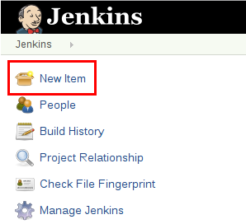
Creating a Multibranch Pipeline
The Multibranch Pipeline project type enables you to implement different Jenkinsfiles for different branches of the same project.
This eliminates the need for manual Pipeline creation and management.
To create a Multibranch Pipeline:
Click New Item on Jenkins home page.
Enter a name for your Pipeline, select Multibranch Pipeline and click OK.

Slide 15
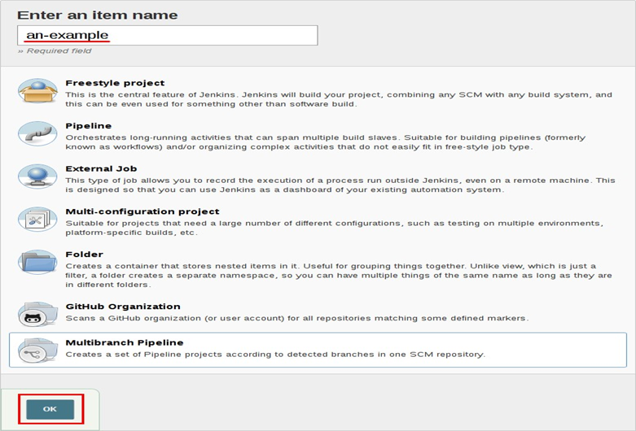
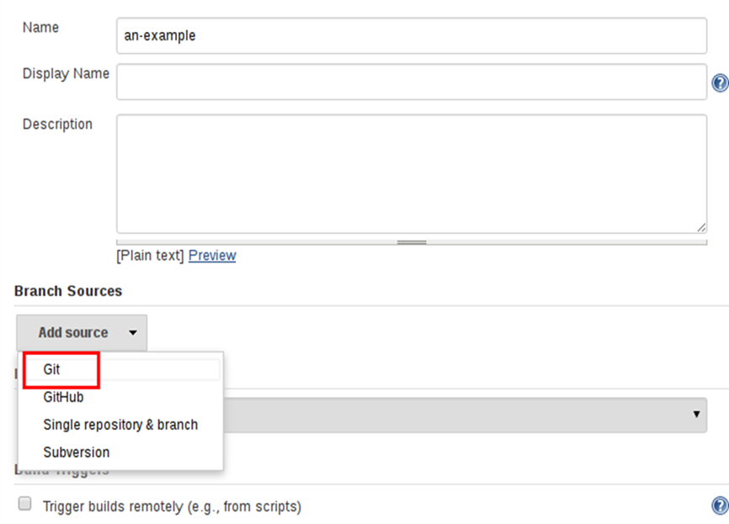
Add a Branch Source (for example, Git) and enter the location of the repository. Save the Multibranch Pipeline project.

Slide 16
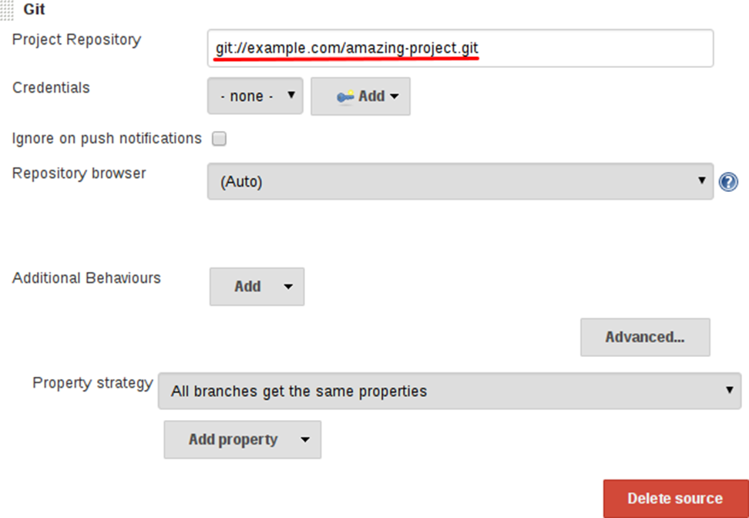
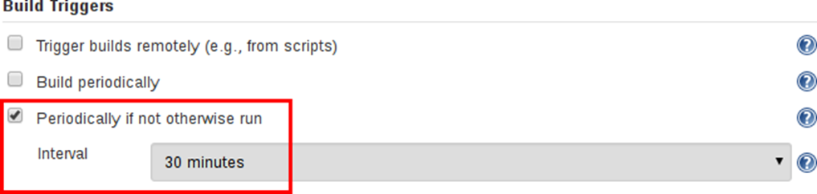
By default, Jenkins will not automatically re-index the repository for branch additions or deletions (unless using an Organization Folder), so it is often useful to configure a Multibranch Pipeline to periodically re-index in the configuration

Slide 17
Additional Environment Variables:
Multibranch Pipelines expose additional information about the branch being built through the env. A global variable, such as:
BRANCH_NAME
Name of the branch for which this Pipeline is executing, for example, master.
CHANGE_ID
An identifier corresponding to some kind of change request, such as a pull request number
Additional environment variables are listed in the Global Variable Reference
Supporting Pull Requests:
With the "GitHub" or "Bitbucket" Branch Sources, Multibranch Pipelines can be used for validating pull/change requests. This functionality is provided, respectively, by the plugin: GitHub-branch- source[GitHub Branch Source] and plugin: cloudbees-bitbucket-branch-source[Bitbucket Branch Source] plugins.
Using Organization Folders:
Organization Folders enable Jenkins to monitor an entire GitHub Organization or Bitbucket Team/Project and automatically create new Multibranch Pipelines for repositories that contain branches and pull requests containing a Jenkinsfile.

Slide 18
Using Docker with Pipeline
Many organizations use Docker to unify their build and test environments across machines, and to provide an efficient mechanism for deploying applications. Starting with Pipeline versions 2.5 and higher, Pipeline has built-in support for interacting with Docker from within a Jenkinsfile.
Customizing the environment variables:
Pipeline is designed to easily use Docker images as the execution environment for a single Stage or the entire Pipeline. Meaning that a user can define the tools required for their Pipeline, without having to manually configure agents. Practically any tool which can be packaged in a Docker container. can be used with ease by making only minor edits to a Jenkinsfile.
The below is the syntax for declaring the pipeline for docker image
pipeline {
agent {
docker { image 'node:7-alpine' }
}
stages {
stage('Test') {
steps {
sh 'node --version'
}
}
}
}

Slide 19
When the Pipeline executes, Jenkins will automatically start the specified container and execute the
defined steps within it:
[Pipeline] stage
[Pipeline] { (Test)
[Pipeline] sh
[guided-tour] Running shell script
+ node –version v7.4.0
[Pipeline] }
[Pipeline] // stage
[Pipeline] }
Catching Data for Containers:
Many build tools will download external dependencies and cache them locally for future re-use. Since containers are initially created with "clean" file systems, this can result in slower Pipelines, as they may not take advantage of on-disk caches between subsequent Pipeline runs.
Pipeline supports adding custom arguments which are passed to Docker, allowing users to specify custom Docker Volumes to mount, which can be used for caching data on the agent between Pipeline runs.
Using Multiple Containers:
It has become increasingly common for code bases to rely on multiple, different, technologies. For example, a repository might have both a Java-based back-end API implementation and a JavaScriptbased front-end implementation. Combining Docker and Pipeline allows a Jenkinsfile to use multiple types of technologies by combining the agent {} directive, with different stages.
Using a Dockerfile:
For projects which require a more customized execution environment, Pipeline also supports building and running a container from a Dockerfile in the source repository. In contrast to the previous approach of using an "off-the-shelf" container, using the agent { dockerfile true } syntax will build a new image from a Dockerfile rather than pulling one from Docker Hub.

Slide 20
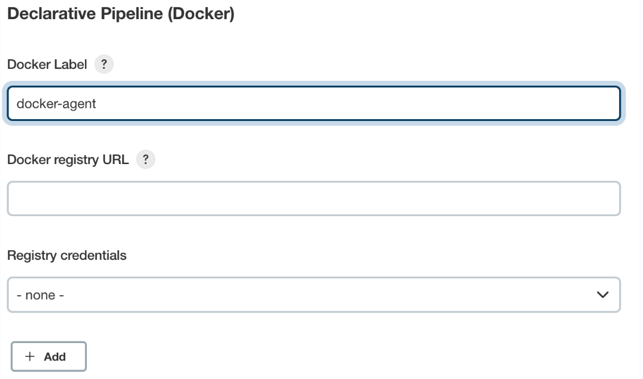
Specifying a Docker Label:
By default, Pipeline assumes that any configured agent is capable of running Docker-based Pipelines. For Jenkins environments which have macOS, Windows, or other agents, which are unable to run the Docker daemon, this default setting may be problematic. Pipeline provides a global option in the Manage Jenkins page, and on the Folder level, for specifying which agents (by Label) to use for running Docker-based Pipelines.

Slide 21
Advanced Usage With Scripted Pipeline
Running "sidecar" containers:
Using Docker in Pipeline can be an effective way to run a service on which the build, or a set of tests, may rely. Similar to the sidecar pattern, Docker Pipeline can run one container "in the background", while performing work in another. Utilizing this sidecar approach, a Pipeline can have a "clean" container provisioned for each Pipeline run.
Building Container:
In order to create a Docker image, the plugin:docker-workflow[Docker Pipeline] is used. This plugin also provides a build() method for creating a new image, from a Dockerfile in the repository, during a Pipeline run. One major benefit of using the syntax docker.build("my-image-name") is that a Scripted Pipeline can use the return value for subsequent Docker Pipeline calls.
Using a remote Docker server:
By default, the plugin:docker-workflow[Docker Pipeline] plugin will communicate with a local Docker daemon, typically accessed through /var/run/docker.sock.
To select a non-default Docker server, such as with Docker Swarm, the withServer() method shouldbe used.
By passing a URI, and optionally the Credentials ID of a Docker Server Certificate Authentication pre-configured in Jenkins, to the method with:
node {
checkout scm
docker.withServer('tcp://swarm.example.com:2376', 'swarm-certs') {
docker.image('mysql:5').withRun('-p 3306:3306') {
/* do things */
}
}
}

Slide 22
inside() and build() methods will not work properly with a Docker Swarm server out of the box
For inside() to work, the Docker server and the Jenkins agent must use the same filesystem, so that the workspace can be mounted.
Currently neither the Jenkins plugin nor the Docker command line interface (CLI) will automatically detect the case that the server is running remotely; a typical symptom would be errors from nested sh commands such as the following example
cannot create /…@tmp/durable-…/pid: Directory nonexistent
When Jenkins detects that the agent is itself running inside a Docker container, it will automatically pass the --volumes-from argument to the inside container, ensuring that it can share a workspace with the agent.
Additionally some versions of Docker Swarm do not support custom Registries.
Using a custom registry:
By default the plugin:docker-workflow[Docker Pipeline] integrates assumes the default Docker Registry of Docker Hub.
In order to use a custom Docker Registry, users of Scripted Pipeline can wrap steps with the withRegistry() method, passing in the custom Registry URL, for example:
node {
checkout scm
docker.withRegistry('https://registry.example.com') {
docker.image('my-custom-image').inside {
sh 'make test'
}
}
}

Slide 23
For a Docker Registry which requires authentication, add a "Username/Password" Credentials item from the Jenkins home page and use the Credentials ID as a second argument to withRegistry():
node {
checkout scm
docker.withRegistry('https://registry.example.com', 'credentials-id') {
def customImage = docker.build("my-image:${env.BUILD_ID}")
/* Push the container to the custom Registry */
customImage.push()
}

Slide 24
THANK YOU

